Slide 1
Digital Architectures for
Artificial Intelligence
Braden Phillips
Michael Liebelt
Brian Ng

Slide 2
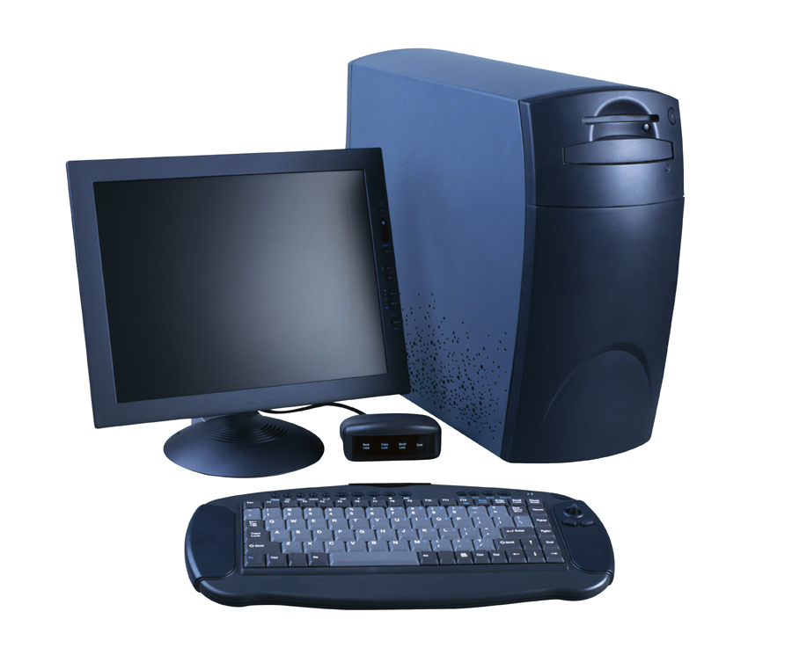
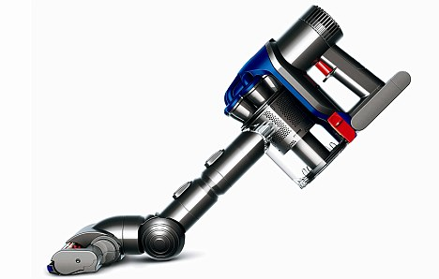
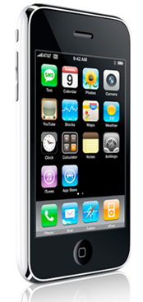

What about the graphics card…
How many processors?
1? 2? 4?
And at least one in here.
…or the network card?
The flash memory chips probably have one each.
There is one in this vacuum cleaner.
There is one in here.
10 in an
iPhone?
Over 100 in a BMW.

Slide 3
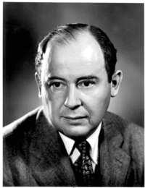
no
microprocessors
John von Neumann

Slide 4
The Problem
Digital electronics has one solution for almost everything:
the von Neumann processor.
It is great for everything from vacuum cleaners to analysing complex civil engineering structures.
It is now very highly optimised.
There are, however, a few things it is not good at. For example:
  Recognition of patterns
  Development of concepts
  Learning
  Open ended problem solving
  Language
  i.e. important aspects of perception, cognition or intelligence

Slide 5
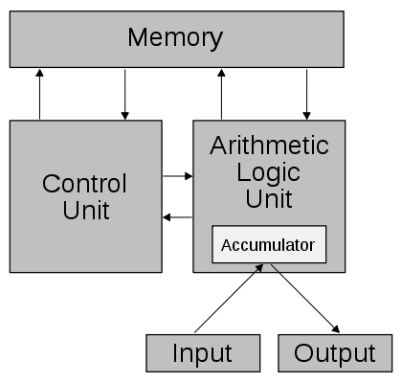
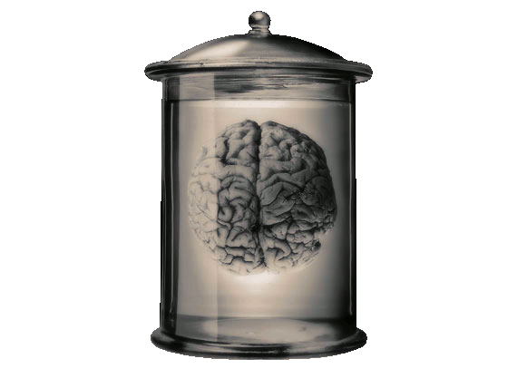
The Project
≠
von Neumann
Processor
?
≈
John von
Neumann’s Brain

Slide 6

2012 Update
Since I gave this presentation at the 2011 expo
We have identified a body of like-minded research
Cognitive Architectures
3 new PhD students have started working on the problem
  Muhammad Usman Khan:
  High Level Abstractions of
  Cognition and Learning
  Francis Li: Holistic Evaluation
  of Cognitive Architectures,
  their Capabilities & Requirements
  Ying Ying Tiong: the Role of
  Memory in Cognition and
  Perception

