Slide 1
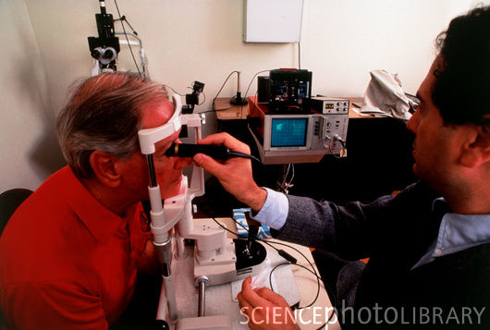
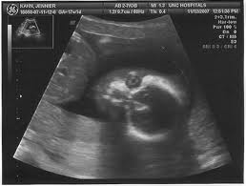
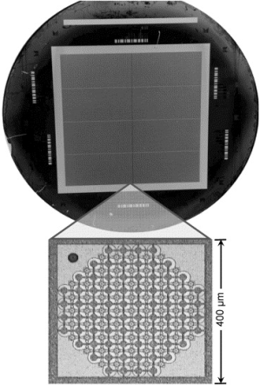
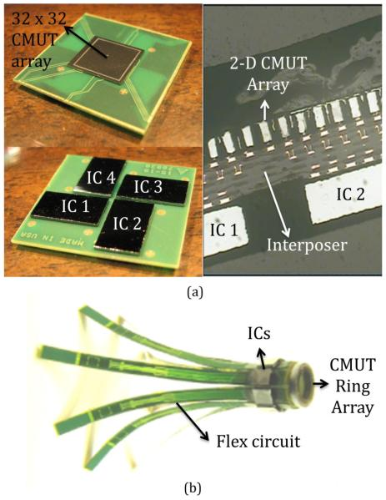
Integrated CMUT Array for Ultrasound Imaging
Three dimensional (3D) ultrasound imaging provides important clinical benefits. In addition to being able to acquire and display volumetric data, the 2D cross-section scans can be obtained at arbitrary orientations relative to the transducer array, thus provide views of anatomy new to ultrasound imaging.
However, 3D ultrasound imaging system is much more complex than 2D imaging. As an example, a 128×128-element array has 16,384 elements, which poses significant data processing and packaging challenges.
A possible solution is to combine the transducer array with an integrated circuit (IC) that results in minimal parasitic capacitance and connection cables. The captured data are routed to the signal process unit via micro-strip interconnections. Capacitive Micro-machined Ultrasound Transducer (CMUT) technique provides the feasibility for the integration of the transducer array together with the analog read-out circuitry.
This project is to explore the integration of the CMUT array and the frontend read-out circuitry by using a high voltage CMOS fabrication process. New bonding techniques, such as flip-chip bonding maybe used to attach the CMUT array chip to the read-out chip. In addition, this project will involve the research and development of ultrasound imaging algorithms, such as the Synthetic Aperture Imaging or Near Field Beamforming techniques to generate final ultrasound images.

