Slide 1
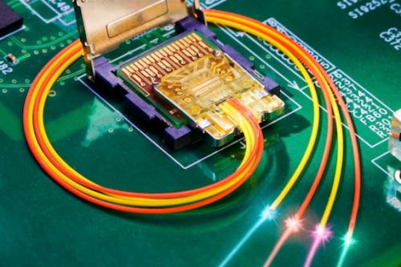
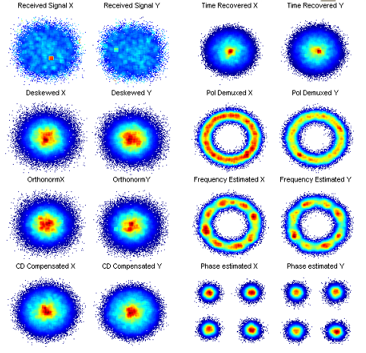
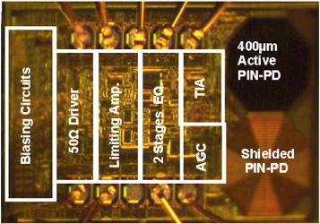
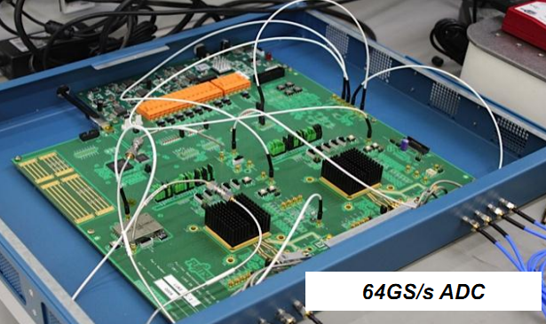
Millimetre-Wave Devices: 100 G and Beyond
Recent years have witnessed an increasing interest in millimetre-wave devices. Rising trends in 100 Gbps optical networks, multimedia devices, automotive radars, remote sensing and T-ray imaging applications are driving forces that draw attention toward developing low cost viable millimetre-wave systems.
Ongoing advances in SiGe bipolar semiconductor technology, with transistor cut-off frequencies in excess of 300 GHz, have enabled circuit designs with maximum signal frequencies well beyond 100 GHz. This project will explore the Millimetre-Wave Integrated Circuit (MMIC) design methodology, and develop the optical transceiver chips for targeting 100 Gbps Ethernet, based on a cutting-edge SiGe BiCMOS process. The current IEEE802.3 standard provide 10 Gbps × 10 and 25 Gbps × 4 solutions. However a 60 Gbps optical transceiver frontend will enable the Ethernet speed beyond 100 Gbps.
In addition, research of the pros and corns of direct detection and coherent detection will be involved, together with sub-systems, such as MUX/DEMUX, ultra-high speed data-converters and detection algorithms.

