Slide 1
2012 Research Expo
PhD Topics
Professor Peng Shi

Slide 2
Networked Control Systems
A networked control system
  controllers, sensors and actuators are spatially distributed and connected via a certain digital communication network.
  Examples: data communication, remote medical diagnosis and surgery, security systems, waste water treatment process, and internet-based tele-operation.
Problems include: induced time delays, packet losses and disorder, time-varying transmission intervals, competition of multiple nodes accessing networks, data quantization, clock synchronization among local and remote nodes, and network security and safety.
This project will systematically study the problems of stability and performance analysis; networked control and estimation; network-based fault detection and tolerance; networked identification.

Slide 3
Network-based Fault Reconstruction and Fault-Tolerant Control Design
Fault reconstruction is one of the most important research problems in system control and fault detection.
Fault reconstruction estimates the fault directly, and improves the detecting ability for slow-varying or initial faults.
The aims
  to model and clarify non-uniform sampling, communication delay, packet loss and signal quantization;
  To develop new analysis and design methods for network-based fault reconstruction and fault-tolerant control systems based on existing techniques, such as, sample-data control, impulsive control, stochastic control and variable structure control.

Slide 4
Stability Analysis and Control of Fuzzy Control Systems
Many practical systems can be described by fuzzy models
Examples: mobile robot navigation in dynamic unstructured indoor and outdoor environments, socio-economic.
This project is on stability analysis and control design on nonlinear systems by fuzzy modelling techniques. New methodologies will be developed to cope with parametric uncertainties, time-delays, deterministic and random switching.

Slide 5
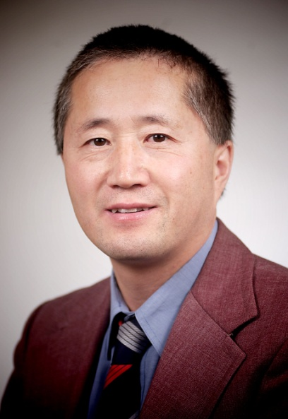
Professor Peng Shi
Dr Shi’s research interests include system and control theory, computational and intelligent systems, and operational research.
He has published widely. His publications include five monographs and over 400 journal papers. His work has received well over 4000 citations, and his H-index is 40.
Current email contact: Peng.Shi@vu.edu.au

