Slide 1

Research activities & opportunities on terahertz microstructures
August 3, 2012
Withawat Withayachumnankul
T-ray Group & Applied Electromagnetics Group
School of Electrical & Electronic Engineering
The University of Adelaide, Australia

Slide 2
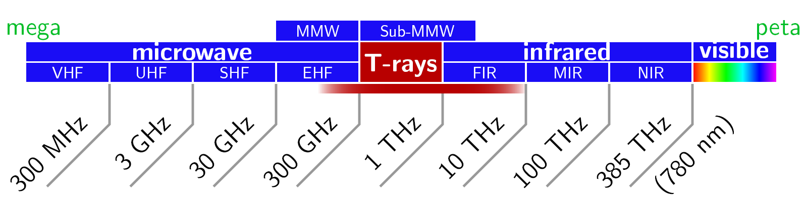
Terahertz radiation
Terahertz spectrum lying between 0.1 and 10.0 THz
Usually referred to as ‘terahertz gap’
Electronic approach hindered by conduction loss & parasitic capactitance
Thermal sources swamped by thermal background radiation at room temperature

Slide 3
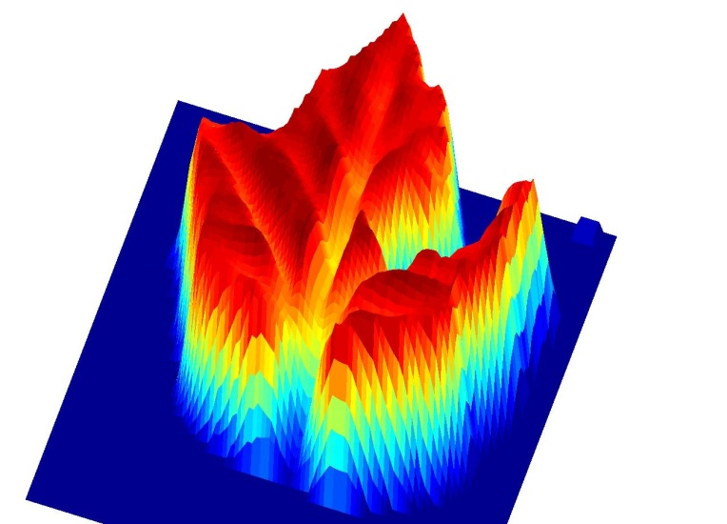
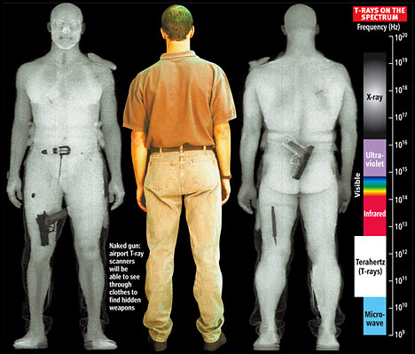
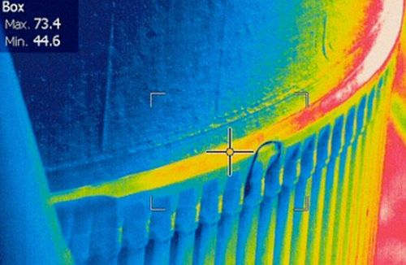
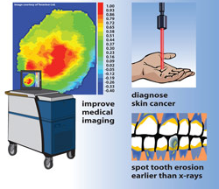
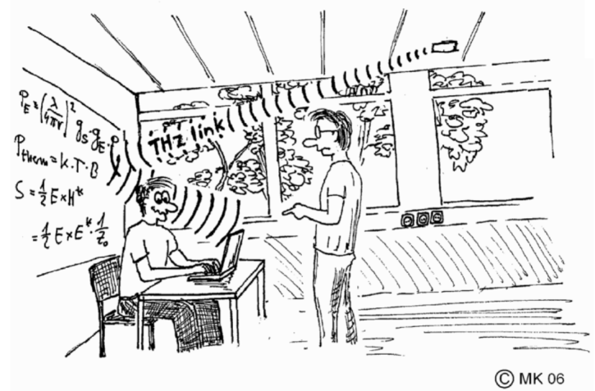
Potential applications
Spectroscopy
Security screening
Nondestructive evaluation
Medical diagnosis
Short-range communication

Slide 4
Selected research activities on terahertz microstructures
Fishnet structure for negative refractive index
Plasmonic coaxial cavities
Strain sensors
Biomolecular sensors
Reflectarrays
Magnetic plasmon waveguides

Slide 5
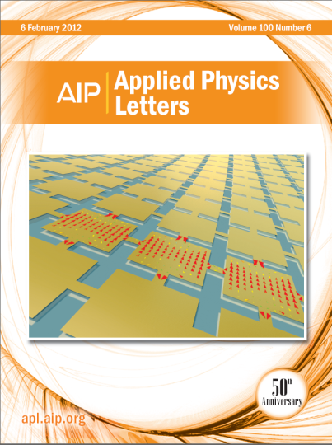
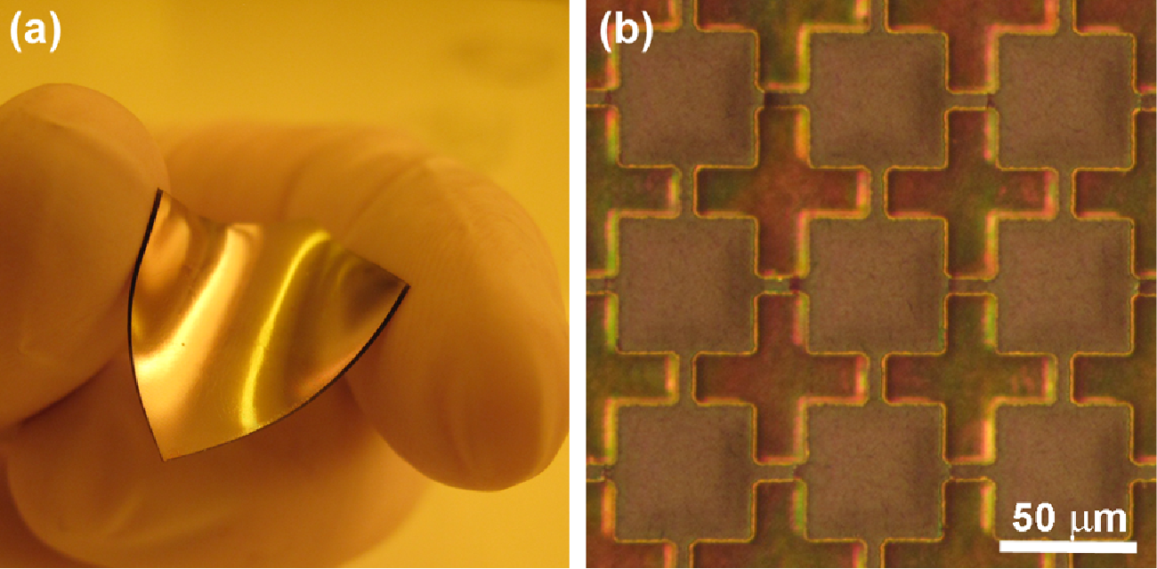
Fishnet structure for negative refractive index

Slide 6
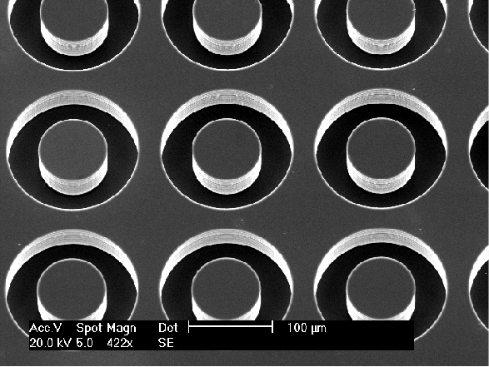
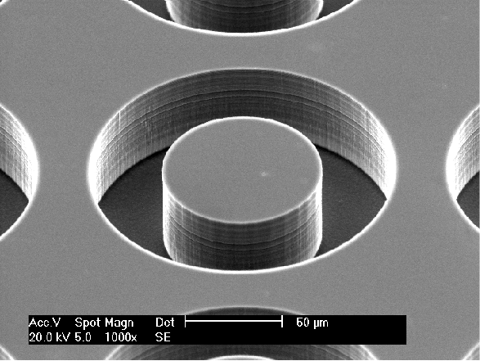
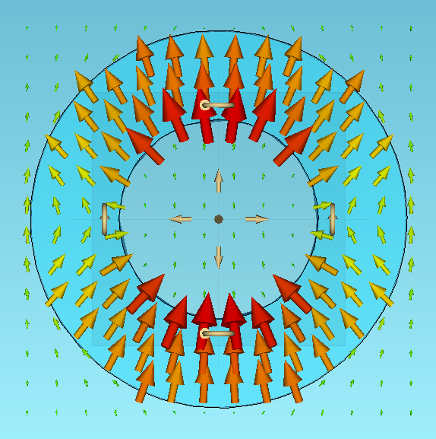
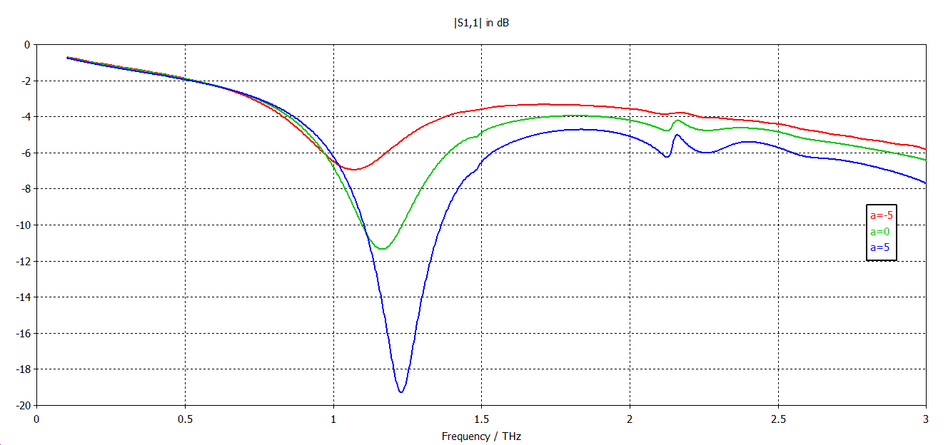
Plasmonic coaxial cavities

Slide 7
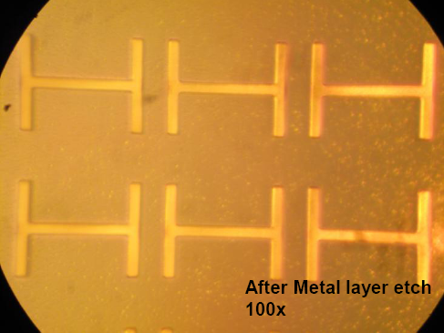
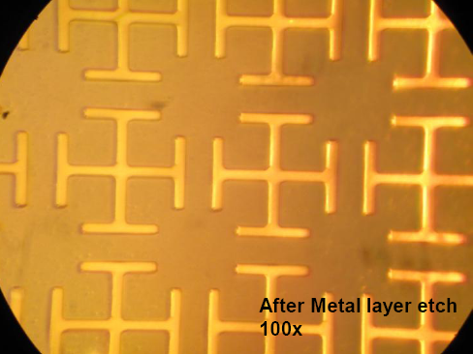
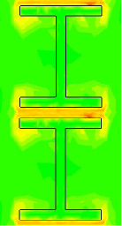
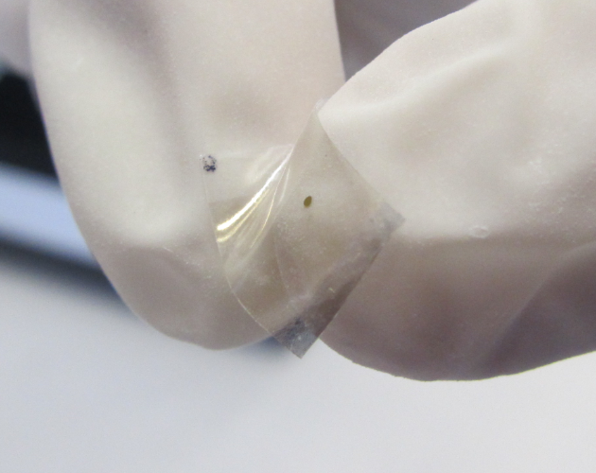
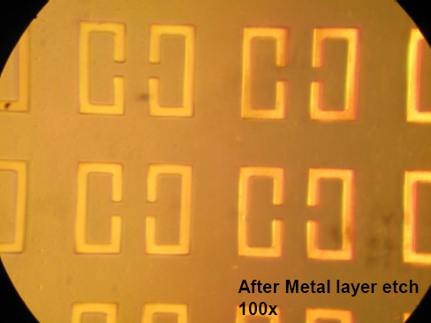
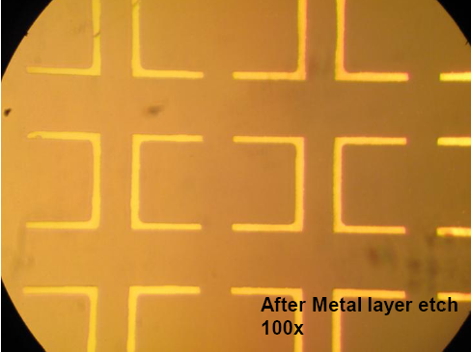
Strain sensors
E
k
H

Slide 8
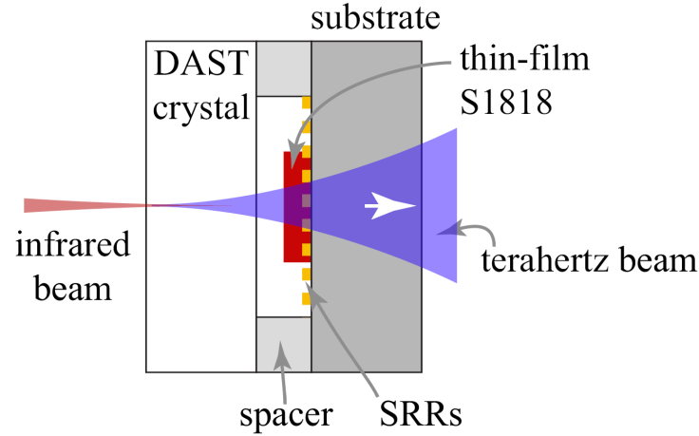
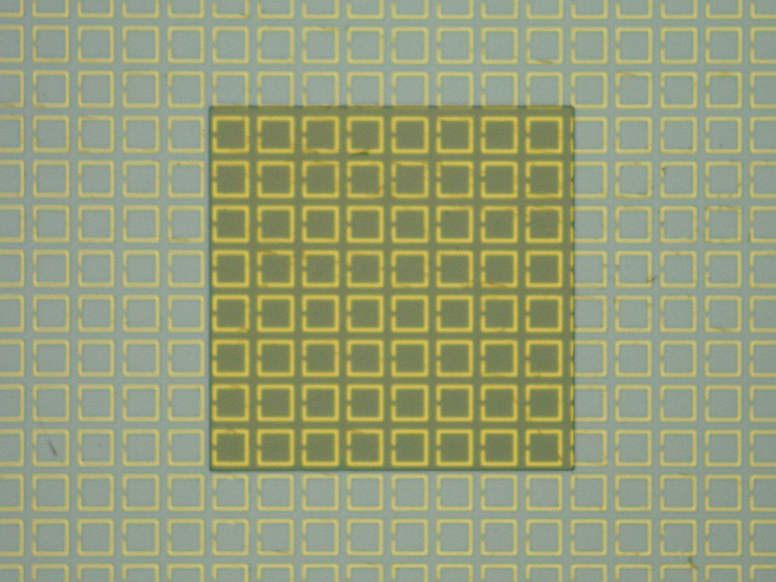
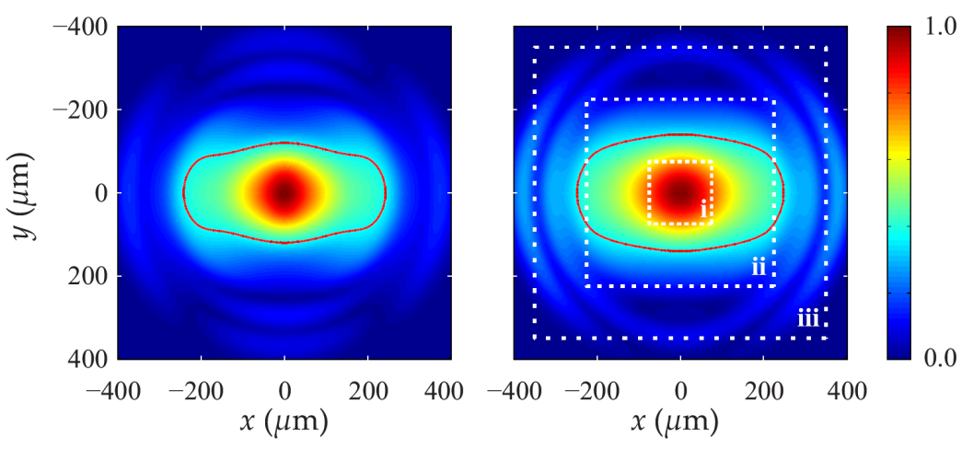
Biomolecular sensors
Near-field system
Metasurface partially loaded with thin film
Cross section of terahertz beams
from full-wave simulation
(left) 25 µm, (right) 50 µm from
DAST crystal

Slide 9
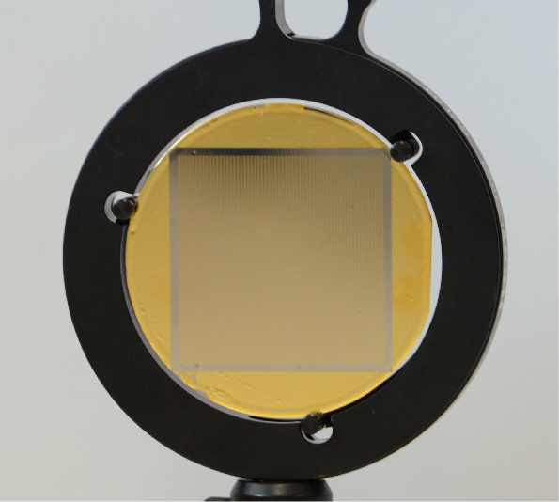
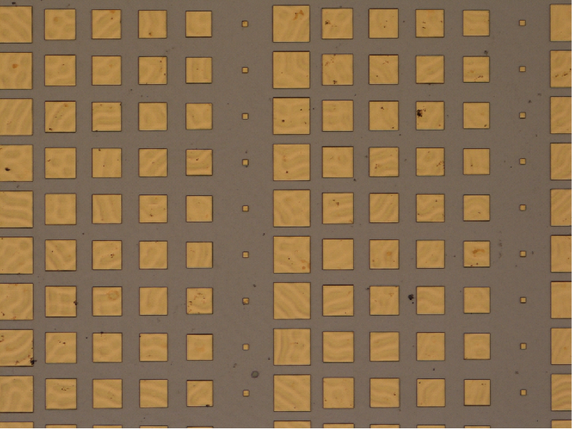
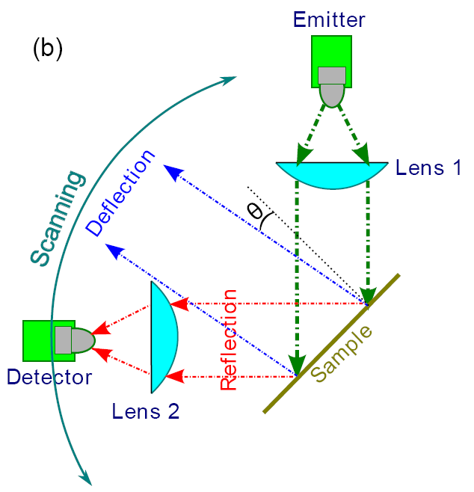
Reflectarray antennas

Slide 10
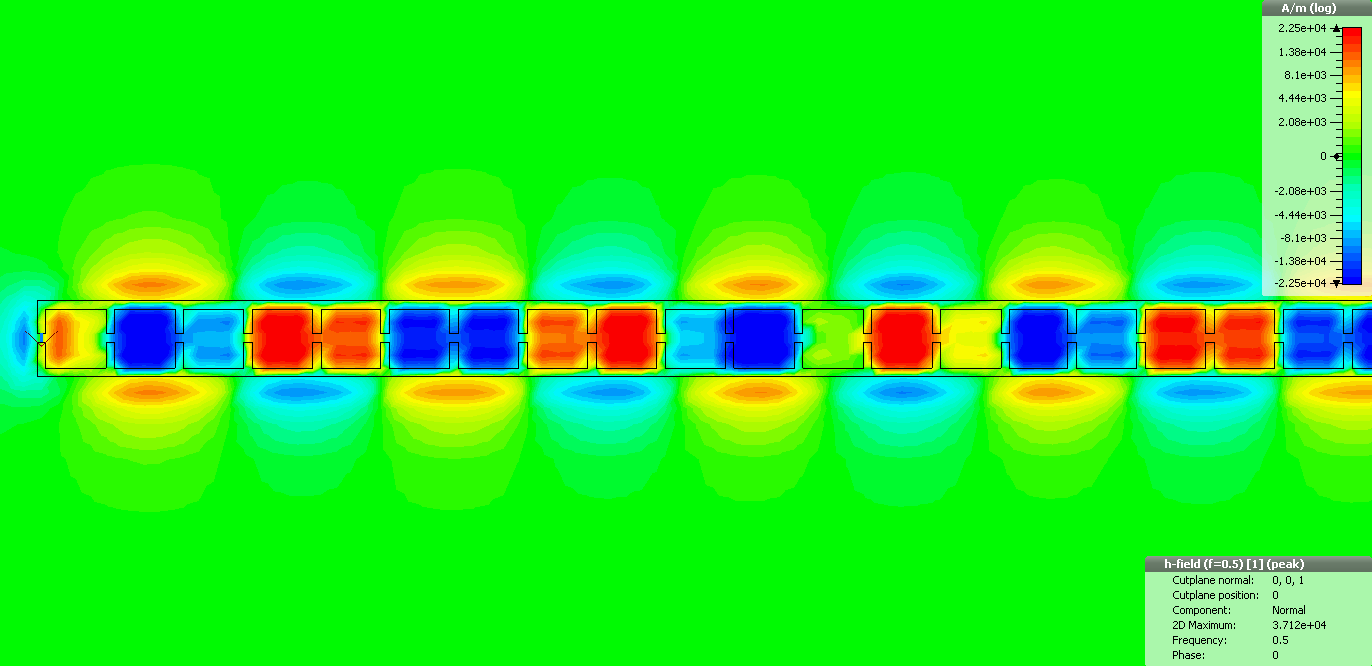
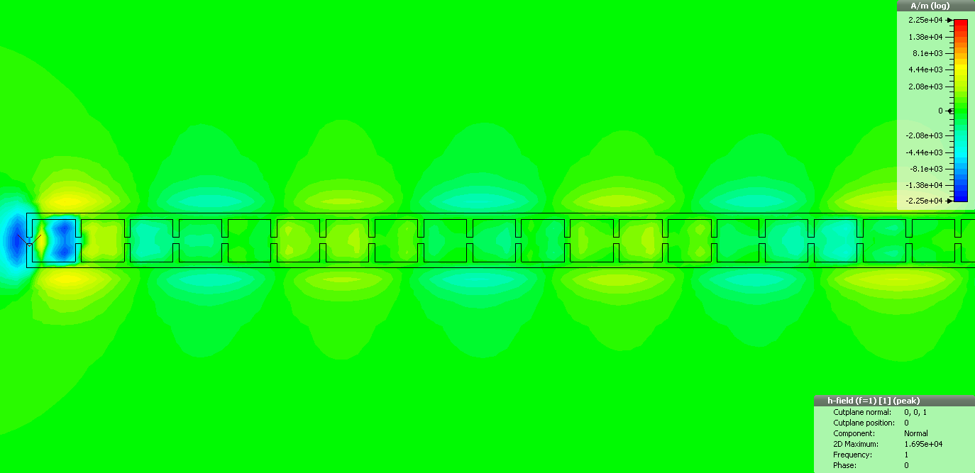
Magnetic plasmon waveguide
Normal H-field at 0.5 THz
Normal H-field at 1.0 THz

Slide 11








Collaborators
Prof. Arnan Mitchell, Dr. Sharath Sriram, Dr. Madhu Bhaskaran, Charan Shah, Functional Materials and Microsystems Research Group, RMIT, Melbourne
Prof. Masayoshi Tonouchi, Institute of Laser Engineering, Osaka U, Japan
Prof. Weili Zhang, Dr. John O’Hara, Dr. Ranjan Singh, Oklahoma State U, USA
Dr. Markus Walther and Korbinian Kaltenecker, University of Freiburg, Germany
Dr. Bernd Fischer, University of Marburg, Germany
Dr. Ibraheem Al-Naib, INRS-EMT, Canada
Dr. Adisorn Tuantranont, Nanoelectronics and MEMS Laboratory, NECTEC, Thailand
Prof. Hui Liu, National Lab of Solid State Microstructures, Nanjing University, China

Slide 12

Special thanks
Prof. Derek Abbott
Prof. Christophe Fumeaux
Dr. Hungyen Lin
Benjamin Ung
Andrew Li
Tiaoming Nui
Henry Ho
A part of work in this presentation was supported by the Australian Research Council Discovery Projects funding scheme under Project DP1095151.

Slide 13
Finally…
We have opportunities for prospective PhD students in these sub-fields of terahertz research:
  Terahertz plasmonics
  Dielectric resonators
  Photonic crystals
  Plasmon waveguides
  Microfluidic sensors
  Etc.
Feel free to drop me an email at withawat@eleceng.adeladie.edu.au

