Slide 1
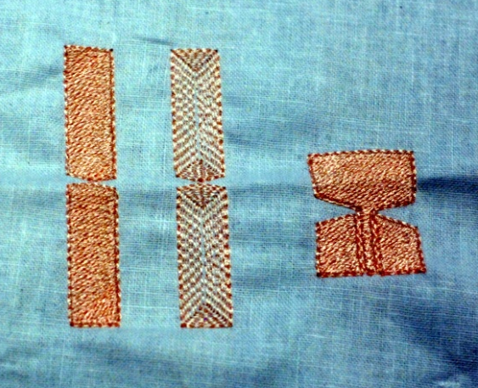
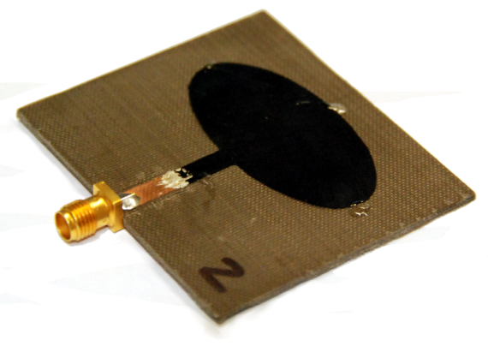
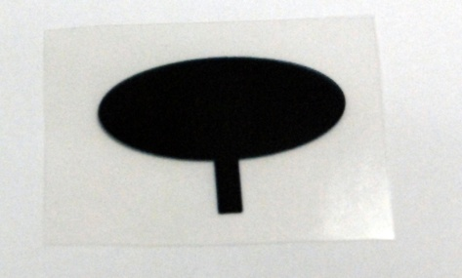
Wearable, Textile and Flexible Antennas
Printing and Embroidering
Conductive Plastics & Metallic Yarns
Thomas Kaufmann
thomaska@eleceng.adelaide.edu.au

Slide 2
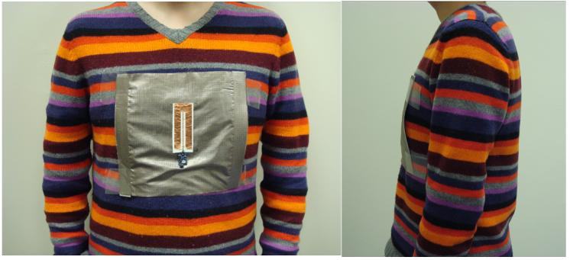
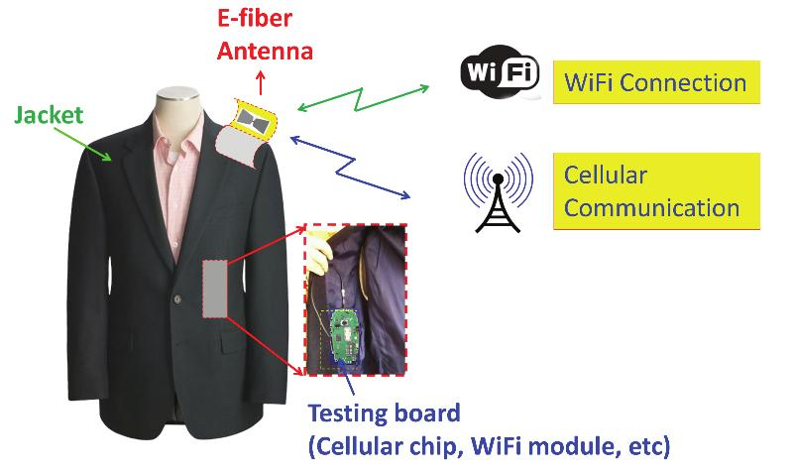
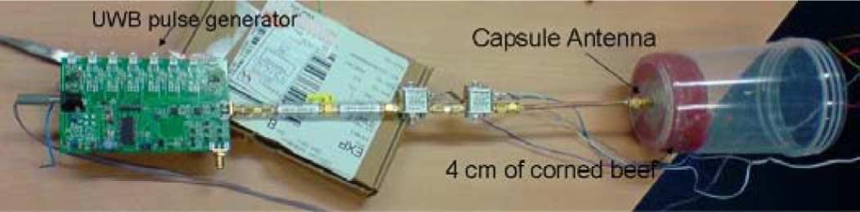
Motivation
Integrate antennas and RF devices into clothes or human body
Medical (Elderly Home, ICU, ...)
Personal Communication
(Smart Phones, GPS, ...)
Tharaka Dissanayake, et. al.
Lanlin Zhang, et. al.

Slide 3
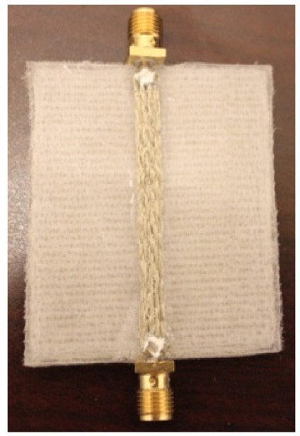
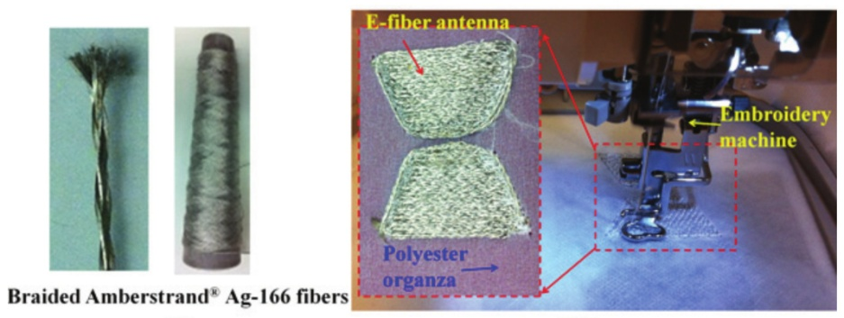
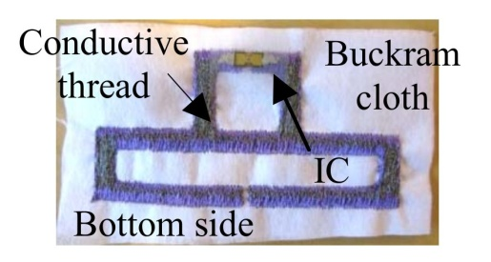
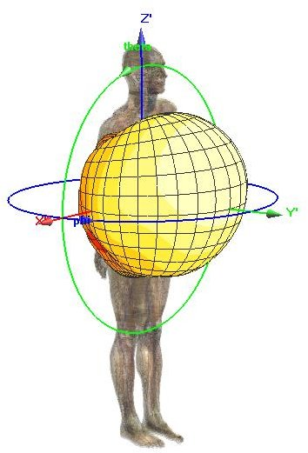
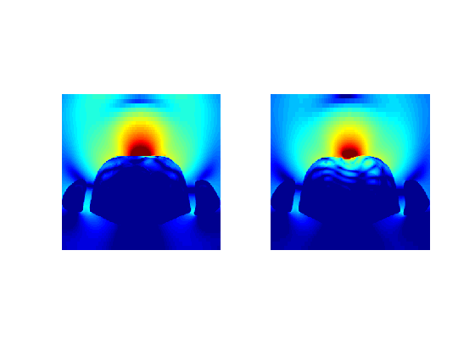
Embroidering onto Fabric
WiFi System
RFID Antenna
Transmission Line
Karoliina Koski, et. al.
Lanlin Zhang, et. al.
Characterise, design and test new antennas and RF devices, and influence from/to human body
Lanlin Zhang, et. al.
Radiation pattern
of antenna
placed on chest
Electric field strength with/without shielding.

Slide 4
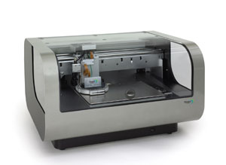
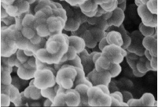
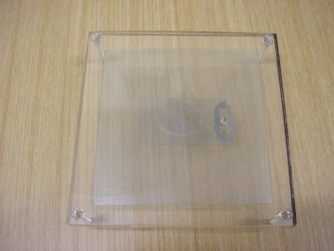
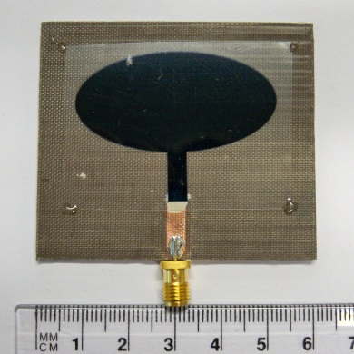
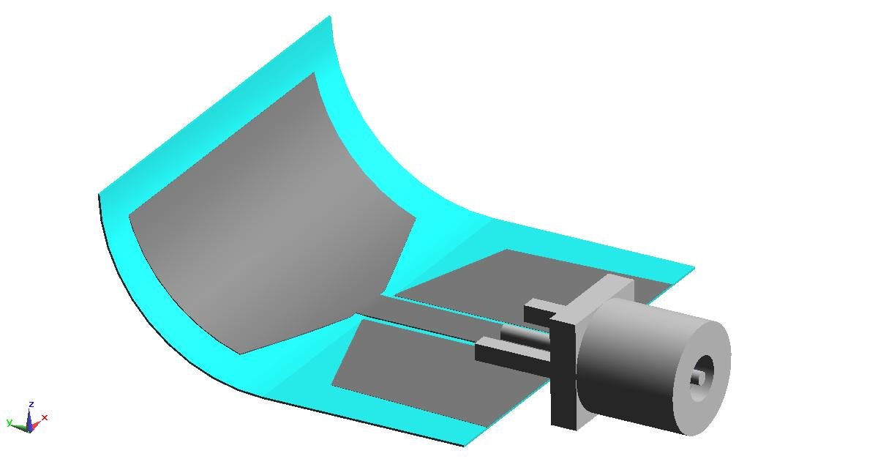
Printing Conductive Polymers
Flexible, printable, low-cost antennas
→ RFID, wearable antennas (BAN)
Bio-compatible, bio-degradable
→ biomedical applications, implants
Optically transparent
→ displays, vehicles, solar panels
Reconfigurable, tunable
→ multi-functions, adaptive antennas
Kirsch, et. al.

Slide 5
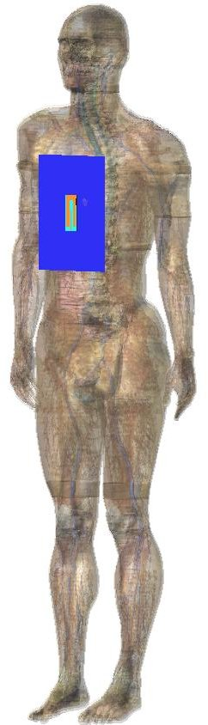
Conclusion
Broad scope and social implications.
Limitless applications.
Wearable electronics is a very “hot” topic.
Interdisciplinary (engineering, material science, tailoring, medicine, ...).
Contact me for further discussions:
thomaska@eleceng.adelaide.edu.au

